Slide 1

Spotify Data Analysis IST 718 Big Data Analytics (group16)
Presented by:
Rahul Dilip Wable
Sanjana Sanjay Bhot
Jaishree Palaniswamy
Aditya Vinod Kini

Slide 2

Agenda
Project Overview
Project Goal
Data Description
Prediction and Inference Goals
Data Exploration and Visualization
Methods Used and Results
Problems Encountered
Future Goals
Prediction and Inference Achievement
Credits

Slide 3
Project Overview
Streaming music platforms are using data collected by consumer interaction to enhance their algorithms, improve user experiences, target audiences with ads, and make overall better-informed business decisions.
Spotify currently has over 108 million paying subscribers—and another 124 million free users—meaning there are billions of streams contributing daily to these processes, whether listeners are directly aware of it or not.

Slide 4
Problem Goal
Goal of our project is to understand the evolution of music over time and the characteristics of various genres of music popular among the users.
Ultimately, we aim to provide recommendations of songs and artists to users based on different features of the user’s playlist.

Slide 5
Data Description
We have explored and analyzed the Spotify dataset available on Kaggle.
Spotify dataset consists of around 160,000 songs released between 1921-2020, including the details about the artist, the year it was published, duration and many such features.
The main dataset (data.csv) consists of 19 columns including the target variable and 169910 rows.
Few available data are grouped by artist, year, or genre as separate CSV files.
Data by the artist – 15 columns and 27622 rows
Data by genres – 14 columns and 2665 rows
Data by year – 14 columns and 101 rows

Slide 6
Column Name | Description
loudness | Overall loudness of a track in decibels (dB).
Mode | Mode indicates the modality (major or minor) of a track
name | Name of the song
popularity | Popularity of the track
speechiness | Speechiness detects the presence of spoken words in a track
tempo | Overall estimated tempo of a track in beats per minute (BPM)
valence | A measure from 0.0 to 1.0 describing the musical positiveness conveyed by a track
year | The year in which the song was released
release_date | Song release Date

Slide 7
Column Name | Description
acousticness | A confidence measure from 0.0 to 1.0 of whether the track is acoustic. 1.0 represents high confidence the track is acoustic
artists | Name of the artist
danceability | Danceability describes how suitable a track is for dancing based on a combination of musical elements including tempo, rhythm stability, beat strength, and overall regularity. A value of 0.0 is least danceable and 1.0 is most danceable.
duration_ms | Duration of the track in milliseconds
energy | Energy is a measure from 0.0 to 1.0 and represents a perceptual measure of intensity and activity
Id | Spotify ID for the track
instrumentalness | Predicts whether a track contains no vocals
key | The estimated overall key of the track. Integers map to pitches using standard Pitch Class notation
liveness | Detects the presence of an audience in the recording

Slide 8


Data Pre-Processing
Data Cleaning
Feature engineering
Identified the Null values in the dataset
Change all columns type into float and dropped duplicate values
Filled null values with 0.00 value
Performed:
1. Vector Assembler
2. Standard Scaler
3. Normalizer

Slide 9
Prediction Goals
Prediction:
Business problem- The central issue for our project is to provide recommendations of songs to a user. Our system will help the users to improve their listening experience which is unique and more personalized to them. It will also help them explore similar artists and genres from a wide range of Spotify playlists of songs.
We aim to gain the following results:
Analysis of artists- Our aim will be to create an artist-based recommendation system that recommends users with similar artists.
Performing time-series analysis- We will also be performing a time series analysis that visualizes the evolution of songs over time to understand the trends in music.
Recommending similar songs- We will be recommending songs by analyzing, differentiating, and clustering the genres.

Slide 10
Inference Goals
Our goal is to use the Linear regression and Random forest regression to identify the relationship within the various attributes for determining the popularity of songs.
Our goal is to use the PCA for the purpose of songs and artists recommendations to the application users from the data generated over the time.
We aim to use the K means clustering algorithms for finding the correlated songs and artists.

Slide 11
Data Exploration
Information investigation can help cut down our large dataset to a reasonable size where we can reduce our efforts for finding the most applicable information.
We decided to find the correlation between the music features and develop various data visualization for finding initial high-level insights.

Slide 12
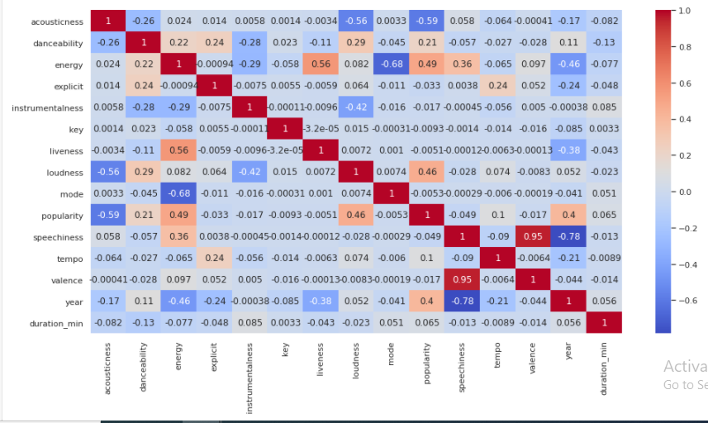
Data Visualization Correlation Matrix

Slide 13
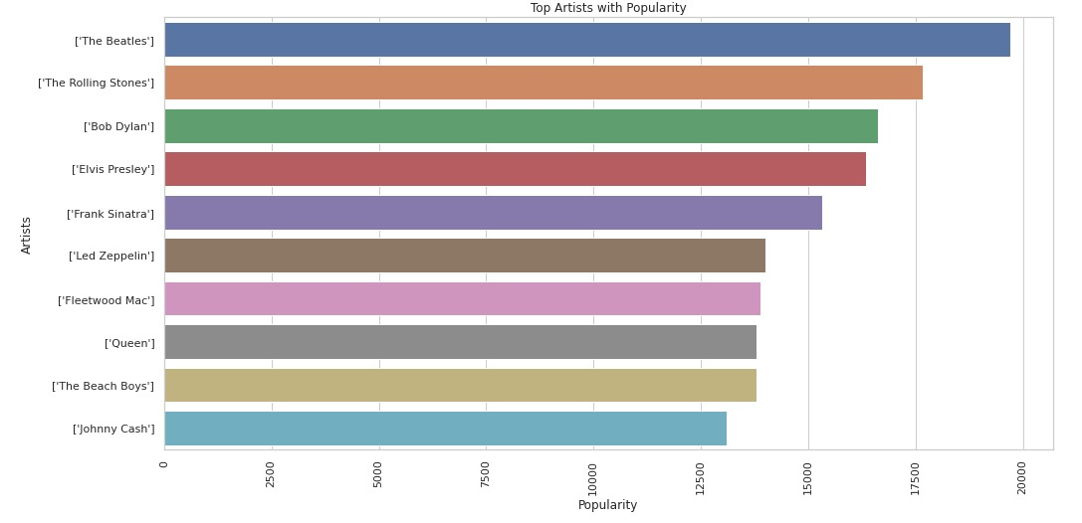
Top Artists with Popularity
(“The Beatles” > “The Rolling Stones” > “Bob Dylan”)

Slide 14
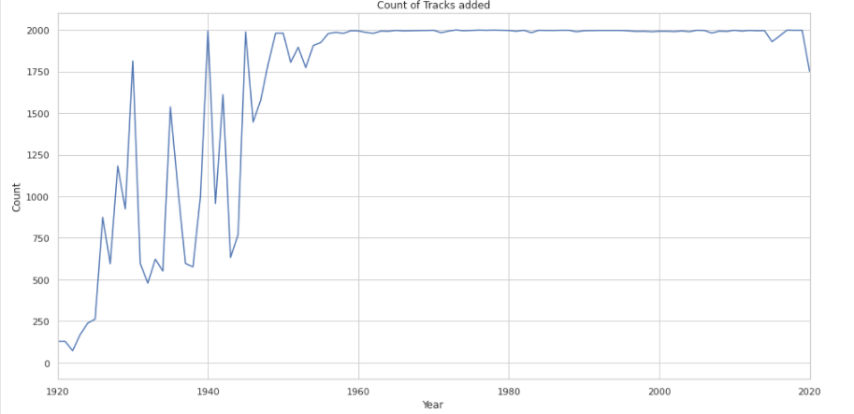
Time Series Analysis: Count of Tracks Added
(Since 1960 the number of new tracks are stable as compared to earlier years)

Slide 15
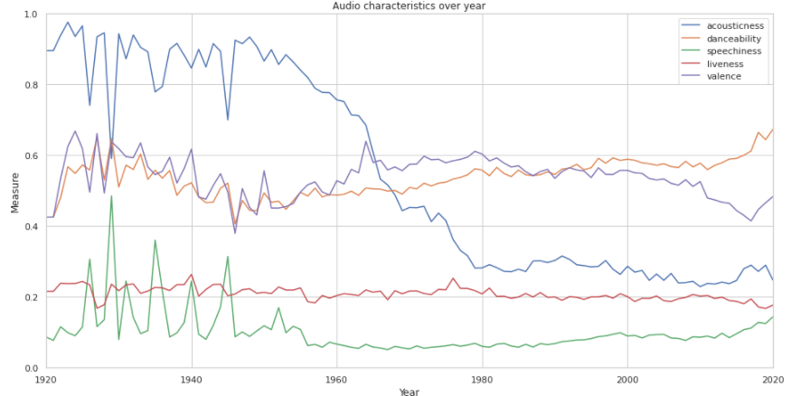
Time Series Analysis: Audio Characteristics Over Year

Slide 16
Methods Used:
Linear Regression
Random Forest Regression
Principal Component Analysis
K means

Slide 17
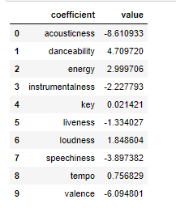
Linear Regression
Root Mean Square Error (RMSE): 15.87

Slide 18
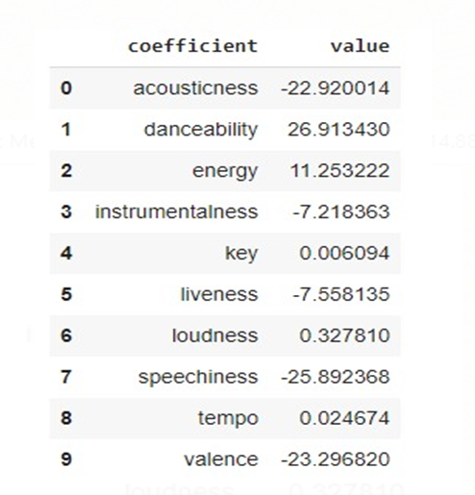
Random Forest Regression
Root Mean Square Error (RMSE): 14.8856

Slide 19
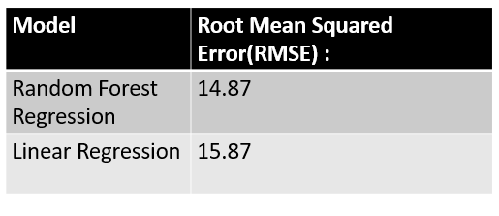
Comparison

Slide 20
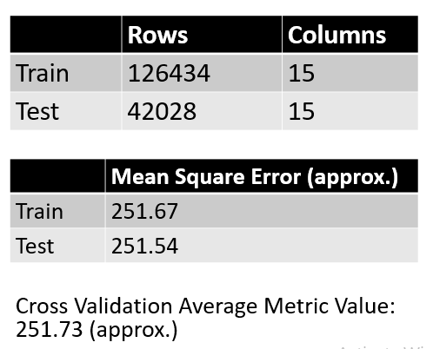
Cross Validation
&
Train and Test Results

Slide 21
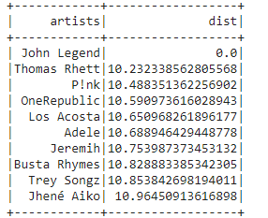
Principal Component Analysis
Artist Recommendations

Slide 22
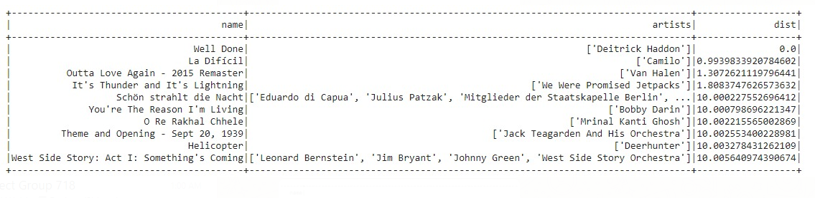

Model Results: Principal Component Analysis (PCA)
Song Recommendations

Slide 23
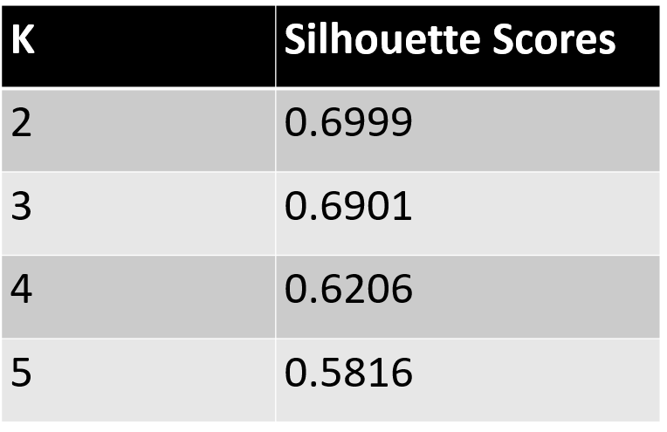
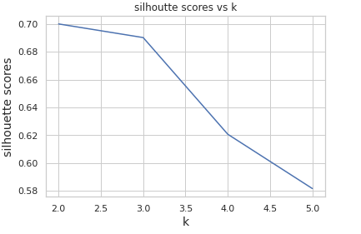
K means
Model Evaluation Comparison

Slide 24
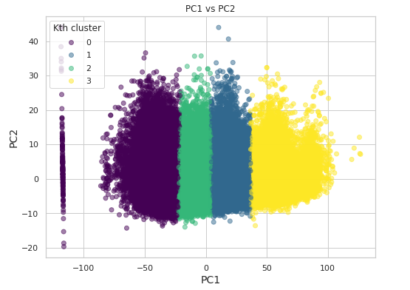
Scatter Plot of K-Means

Slide 25
Prediction and Inference Achievement
From the Linear Regression Model we can conclude that for the songs popularity the important features are acousticness, valence and danceability. The least important feature are key and tempo.
Similarly for Random Forest Regression Model we can conclude that for the songs popularity the important features are acousticness, danceability, speechiness, valence. The least important features are key and tempo again.
Based on both models, acousticness and danceability tend to be the most important features. Thus we can infer that as acousticness increases, the popularity of a song decreases indicating that people prefer less acoustic songs. Moreover, as danceability increases the popularity of a song also increases indicating that people prefer songs that they could dance to.

Slide 26
Problems Encountered
Could not apply other clustering algorithms as it is not supported in PySpark.
Found it difficult to find the results by relating Genres and Popularity
Analyzing K-means clusters
High RMSE value for regression models
Predicting the right insights from the large size of data

Slide 27
Credits
Team Member | Task Accomplished
Rahul Dilip Wable | Project Proposal, Presentation, PCA (recommending artists), K means , Cross-Validation
Sanjana Sanjay Bhot | Project Proposal, Data Pre-Processing, Data Visualization, Linear Regression
Jaishree Palaniswamy | Project Proposal, Data Pre-Processing, Data Visualization, K Means Clustering
Aditya Vinod Kini | Project Proposal, Presentation, Exploratory Data Analysis,PCA (recommending songs), Random Forest Regression

Slide 28
Questions? THANK YOU!!

